Slide 1


B.Tech Short Term Industrial/Research Experience Report On Exploratory Multimodal Data Analysis for Understanding the Mental Health Behavioural Pattern By Aditya Sharma (118EI0714) Under the supervision of Dr. Suchetana Chakraborty At the Department of CSE, IIT Jodhpur Submitted to Dept. of Electronics and Communication Engineering, National Institute of Technology, Rourkela

Slide 2
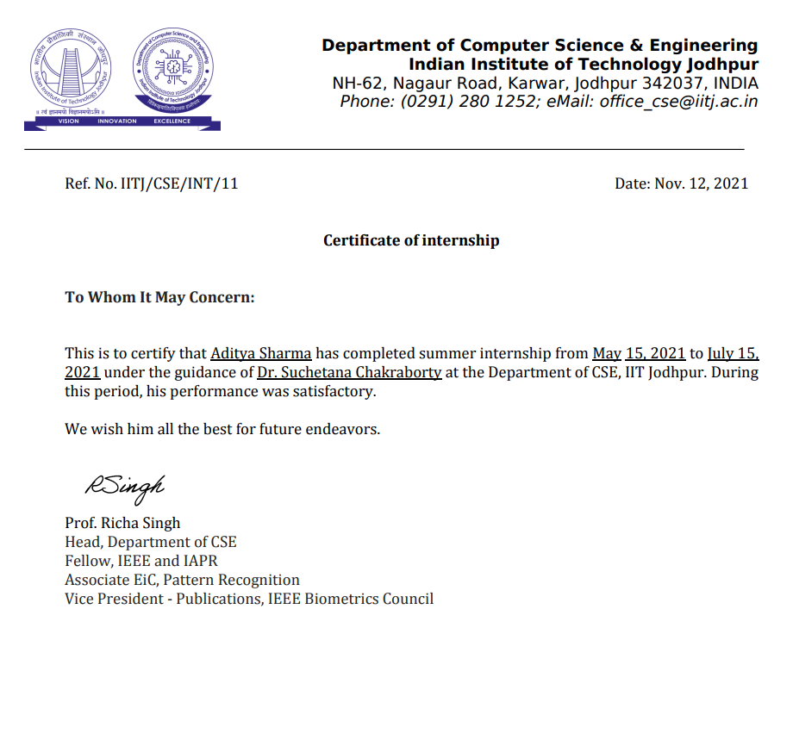
Certificate of Internship

Slide 3
I. Introduction
Depression and anxiety are leading causes of disability worldwide but often remain undetected and untreated.
To assess an individual's mental health, researchers have traditionally relied on questionnaire data delivered by a doctor or self-reported data.
Smartphones, which are equipped with a variety of sensors, give an unobtrusive stream of data on an individual's mental health, such as location, smartphone usage habit, physical activity, and social interactions.
The current research study aimed to explore the extent to which data from smartphone could predict symptoms of depression and anxiety.

Slide 4
II. Assigned Tasks
To explore existing datasets and research studies available online and perform analysis on them for establishing the proposed hypothesis and developing a research model. Perform exploratory data analysis to find out the features and ground truths for the study.
Design and develop a smartphone app for data collection.

Slide 5
III. Data Analysis Part
I was given the task to analyze existing datasets available to find the features that can be measured using smartphone sensors and which have strongest correlation with mental health parameters.
Used python language and various python libraries like Numpy, Pandas, SciPy, Matplotlib, Scikit-learn etc for importing the datasets, cleaning and preparing the data, summarizing the data frame and finding correlation between different features, model development and model evaluation.
Some of the analyzed datasets with the results obtained are shown in the next few slides:

Slide 6
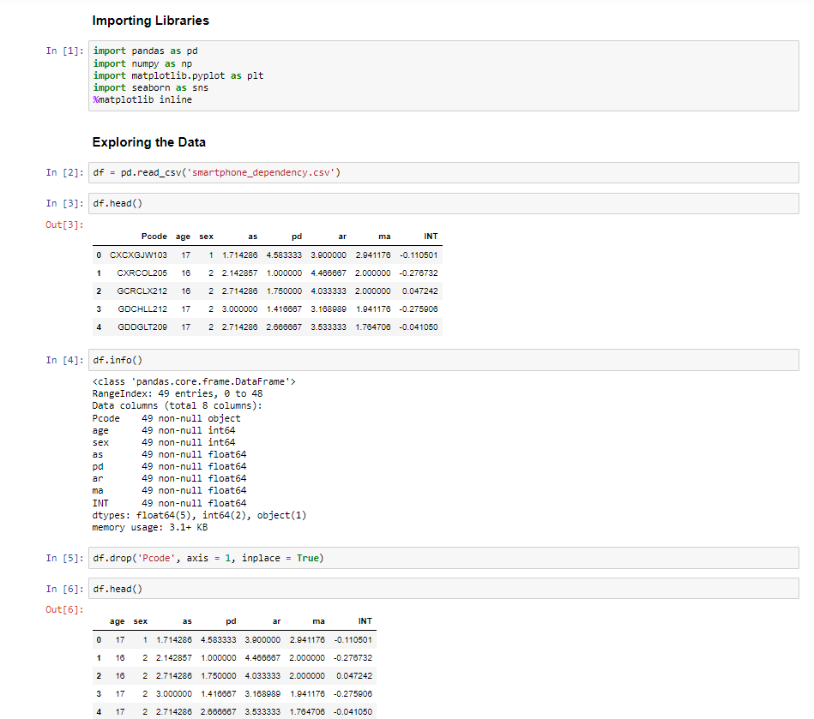
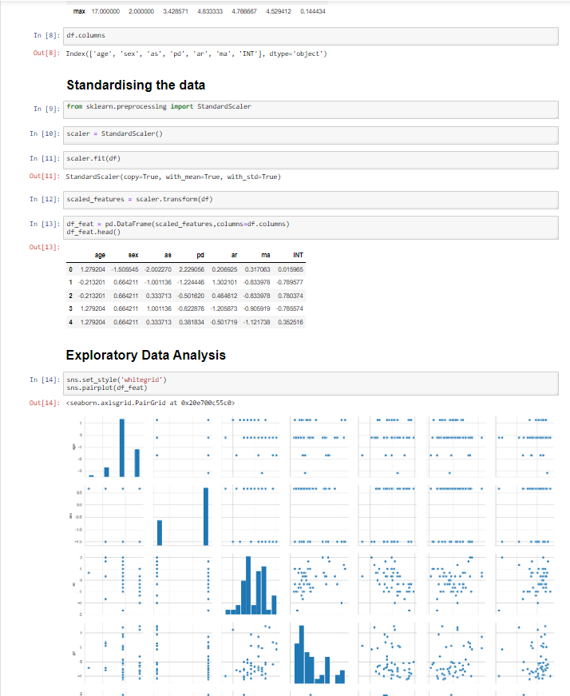
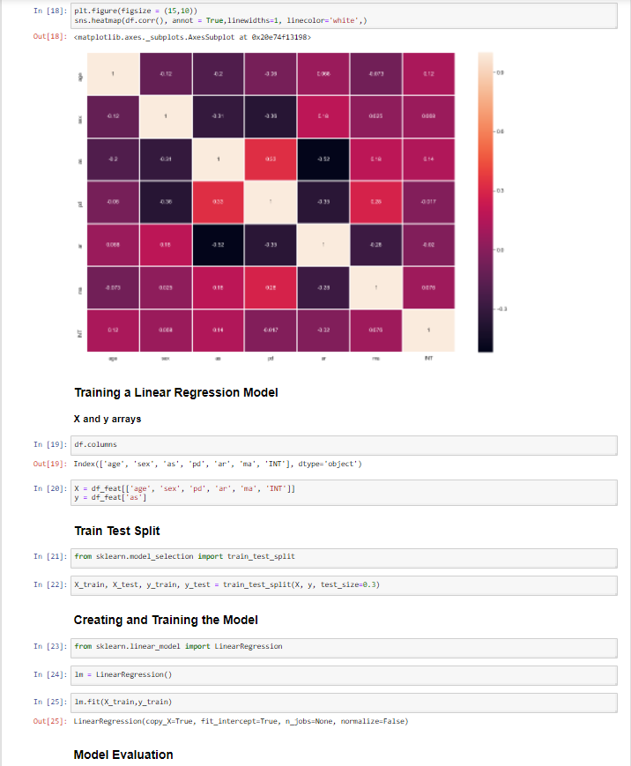
Academic Stress and Smartphone Dependence (link):
Linear regression analysis was used to investigate the relationship among the variables. The results showed that academic stress was positively related to psychological distress, which may further lead to severe smartphone dependence. Psychological distress partially mediated the relationship between academic stress and smartphone dependence. The mediating effect of psychological distress between academic stress and smartphone dependence was moderated by academic resilience. Specifically, academic resilience weakened the indirect relationship between academic stress and smartphone dependence that was mediated by psychological distress.
Observations: The results showed that academic stress was positively related to psychological distress, which may further lead to severe smartphone dependence. Psychological distress partially mediated the relationship between academic stress and smartphone dependence. The mediating effect of psychological distress between academic stress and smartphone dependence was moderated by academic resilience. Specifically, academic resilience weakened the indirect relationship between academic stress and smartphone dependence that was mediated by psychological distress.

Slide 7
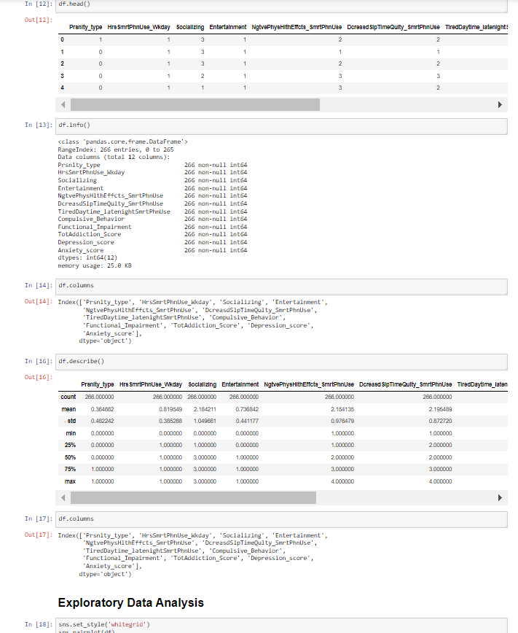
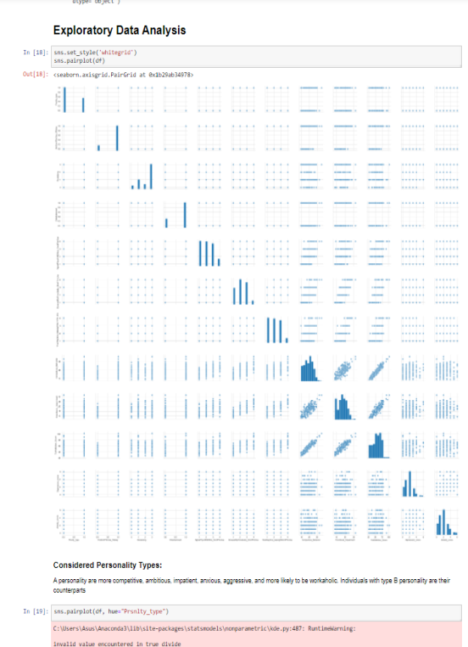
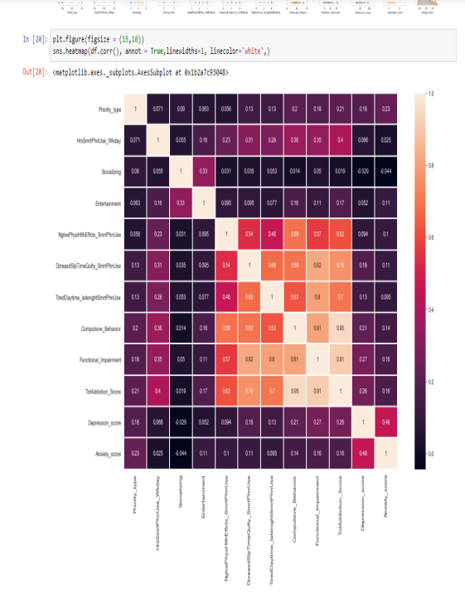
2. Depression, anxiety, and smartphone addiction in university students- A cross sectional study (link) :
The dataset aims to assess prevalence of smartphone addiction symptoms, and to ascertain whether depression or anxiety, independently, contributes to smartphone addiction level among a sample of university students, while adjusting simultaneously for important sociodemographic, academic, lifestyle, personality trait, and smartphone-related variables.
Observations: -> Prevalence rates of smartphone-related compulsive behavior, functional impairment, tolerance and withdrawal symptoms were substantial. -> Depression and anxiety scores emerged as independent positive predictors of smartphone addiction, with depression score being a more powerful predictor compared to anxiety score

Slide 8
IV. Data Collection and Application Development
An android app was designed for data collection.
The application have a simple intuitive interface for users to input their mood and activity information.
The following data are collected by the app:
GPS data
Battery Level
App Usage History
Accelerometer Data
Gyroscope Data

Slide 9
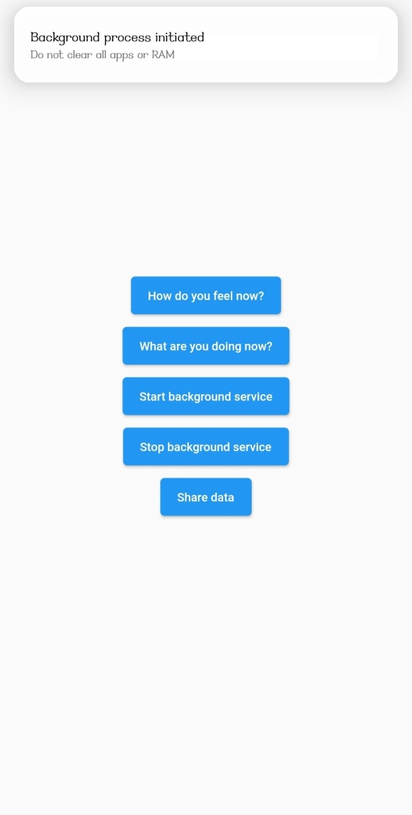
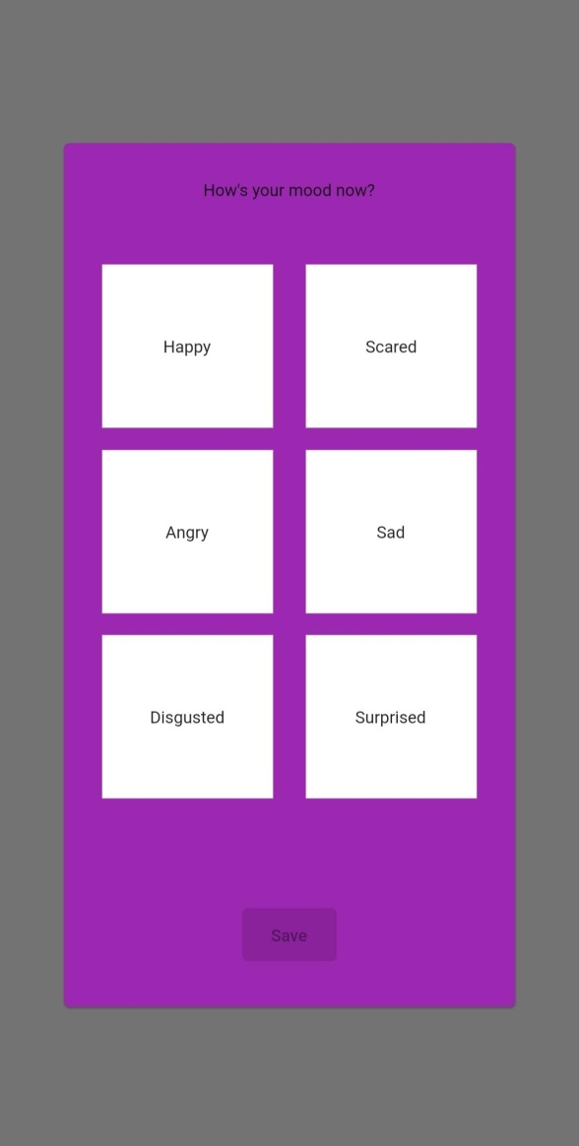
Screenshots of the android application

Slide 10
V. Conclusion
Smartphones may provide a one-of-a-kind opportunity to bypass some of these constraints. Smartphones, which are equipped with a variety of sensors, give an unobtrusive stream of data on an individual's mental health, such as location, smartphone usage habit, physical activity, and social interactions.
During this study we performed data analysis on various datasets and found out that GPS data (location variance on depression), sleep time, accelerometer data (physical activity), heart rate, sociability were able to predict symptoms of depression and anxiety.
By analyzing different datasets we found that GPS data, sociability, sleep time, physical activity have some negative correlation with depression which means the more a person do these activities the less depressed he/she tends to be.
Based on the features found, a smartphone application was designed for data collection.

Slide 11
VI. References
World Health Organization. Depression and Other Common Mental Disorders: Global Health Estimates. Geneva(2017).Available online at: https://www.who.int/mental_health/management/depression/prevalence_global_health_estimates/en/ (accessed April 12, 2020).
Mental Health - Household Pulse Survey - COVID-19. (2020). Available online at: https://www.cdc.gov/nchs/covid19/pulse/mental-health.htm
Smartphone sensing methods for studying behavior in everyday life (2017) available at: http://dx.doi.org/10.1016/j.cobeha.2017.07.018
Patterns of behavior change in students over an academic term: A preliminary study of activity and sociability behaviors using smartphone sensing methods (2016) available at: https://www.journals.elsevier.com/computers-in-human-behavior
DeepMood: Forecasting Depressed Mood Based on Self-Reported Histories via Recurrent Neural Networks (2017) available at: https://dl.acm.org/doi/10.1145/3038912.3052676
Mental health monitoring with multimodal sensing and machine learning: A survey (2018) available at: https://www.journals.elsevier.com/pervasive-and-mobile-computing
The Jigsaw Continuous Sensing Engine for Mobile Phone Applications (2010)
Depression, anxiety, and smartphone addiction in university students- A cross sectional study (2017) available at: https://journals.plos.org/plosone/article?id=10.1371/journal.pone.0182239
StudentLife: Assessing Mental Health, Academic Performance and Behavioral Trends of College Students using Smartphones and StudentLife Dataset 2014. http://studentlife.cs.dartmouth.edu/.
SmartGPA: How Smartphones Can Assess and Predict Academic Performance of College Students
Vallance JK, Winkler EAH, Gardiner PA, Healy GN, Lynch BM, Owen N. Associations of objectively-assessed physical activity and sedentary time with depression: NHANES (2005-2006).
O’Brien JT, Gallagher P, Stow D, Hammerla N, Ploetz T, Firbank M, et al. A study of wrist-worn activity measurement as a potential realworld biomarker for late-life depression. Psychol Med. (2017) 47:93–102. doi: 10.1017/S0033291716002166
Saeb S, Zhang M, Karr CJ, Schueller SM, Corden ME, Kording KP, et al. Mobile phone sensor correlates of depressive symptom severity in daily-life behavior: An exploratory study. J Med Internet Res. (2015) 17:1–11. doi: 10.2196/jmir.4273

Slide 12
Thank You

